Slide 1
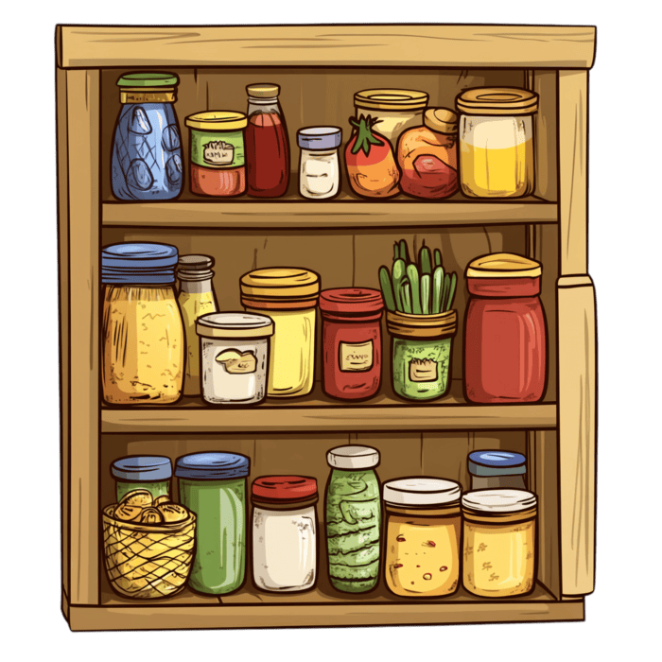
Pantry Pal
-Team Blue-
Team Members: Noel Mehari, Robel Arega, Linh Bui

Slide 2
Product Purpose
Problem
-People forget what food they already have.
-Items run out unexpectedly.
-Expiration dates are often hard to track.
-Grocery lists are often unorganized and an inconvenience.
Relevance
-Accidentally buying duplicates of items you already own hurts the wallet.
- Keeping track of expiration dates becomes a hassle often demotivating people to do it consistently.
3. Solutions
- With the PantryPal users will be able to remotely track their items.
- Users will be notified when an item is close within its expiration date.

Slide 3
Product Overview
App Description:
Pantry Pal is a single user offline desktop application designed to help users manage pantry items. The application allows users to store information about food items they have at home, including quantity, description, category, and expiration date. All data is stored locally in a relational database and the application focuses on providing simple and reliable CRUD functionality without requiring internet access.
Target audience includes but isn’t limited to: Users living on their own, Users in charge of family groceries, nannies or babysitters, etc.

Slide 4
Key MVP features and functionality
● Create:
-Add pantry items with name, category, quantity, description and expiration date.
-Items are saved to a local relational database.
-Items are sorted by soonest expiration date, then by order added.
● Retrieve:
-View the full pantry list at any time.
-Display item name, category, quantity, description and expiration date.
-Confirm items were properly added to the database.

Slide 5
Key MVP features and functionality
● Update:
-Update item information.
-Automatically identify and notify users of expired items.
● Delete:
-Delete expired or unwanted pantry items.
-Permanently remove items from the database.

Slide 6
Tech stack and tools used
-Clion
-MySQL
-GitHub

Slide 7
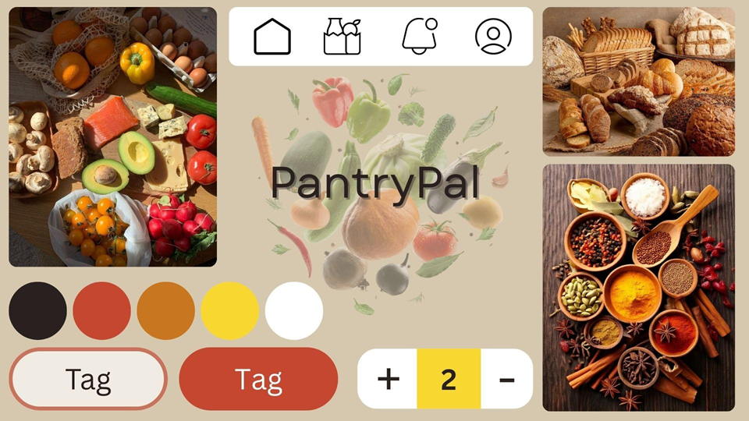

Slide 8
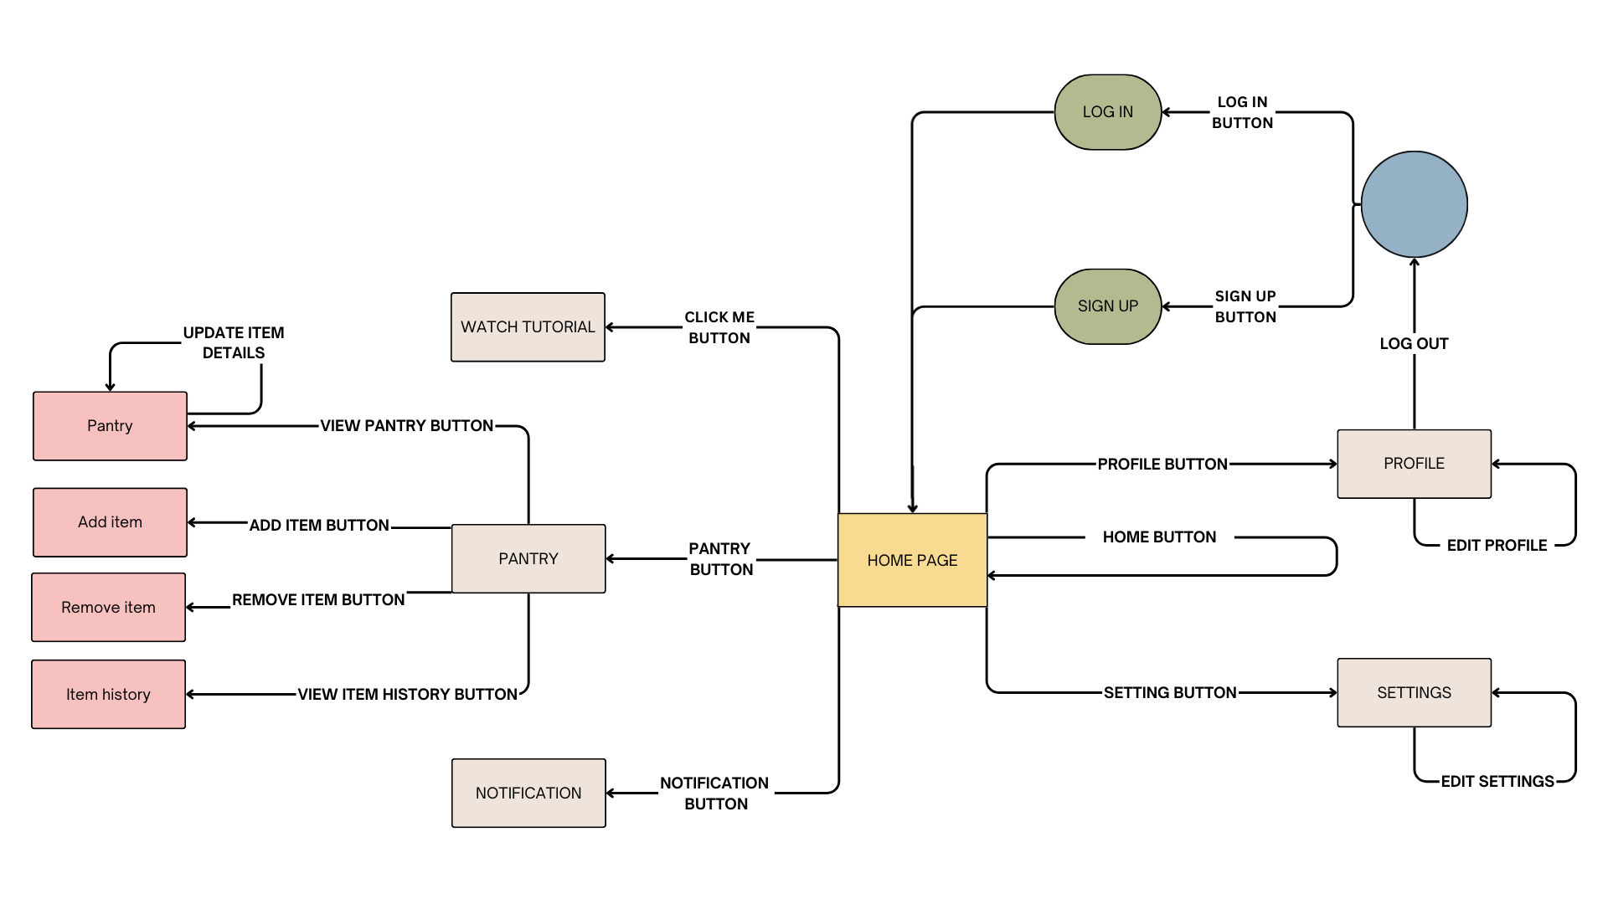
Wireframes

Slide 9
Team dynamics and health
How your team worked together:
We used Github to share our work and kept in constant communication via text messages or email, which made building the project very efficient and straightforward.
Two challenges your team overcame:
- Different schedules
- Figuring out how to configure C++ with the MySQL database.
At least two team learnings:
- Learning MySQL for the first time.
- Learning the process of App development (ERD, Wireframe, etc).

Slide 10
Project Takeaways
Noel:
1. Something that I struggled with at first was learning MySQL.
2. Something that I enjoyed learning was the App development process altogether.
3. Something that I will definitely apply in future work is the ERD.
Robel:
1. Something I struggled with was the process of learning how to use MYSQL
2. Something I liked learning was how intricate app development can be and how important detail is.
3. Something I hope to apply in the future is the ERD and Mood board.
Linh:
1. Something that I struggled with was connecting Clion to MySQL.
2. Something that surprised me is how important clear communication is.
3. Something that I will apply in future work is the moodboard.

Slide 11
Product Demo

